Slide 1
The Story of Indian Engineering
-Srimmati SriniVaSAN
XBBNGHQ

Slide 2




Did You Know..?

Slide 3
Olympics
India
China
28- 9 gold
7 silver
12 bronze
100 medals in the year 2008 itself

Slide 4
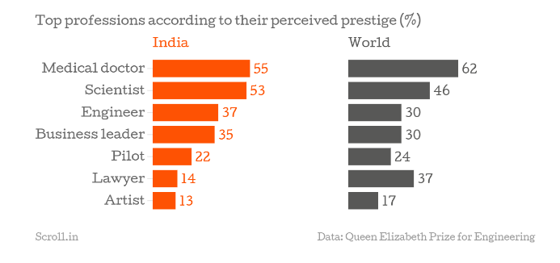
Statistics

Slide 5
Thing about Bangalore
Full of frustrated Engineers
Statistics say that 1 in 20 IT employee commit suicide.

Slide 6
How it all started
British came to India
Indians took English as a pride more than a language.
IT Revolution happened in India and not in China because of our familiarity with English.

Slide 7
Indian Engineers in America
4th of Oct 1957,7:28 PM.
America imported Engineers from India.
Indians preferred America because they are comfortable with English.

Slide 8
Engineering Colleges
IIT Obsession in India.
IIT’s became one of the means for the Indian middle class for their social upliftment.

Slide 9
Chase for the obsession
Hyderabad and Kanpur.
Gang war between the coaching professors.
20 kids every day commit suicide in India.

Slide 10
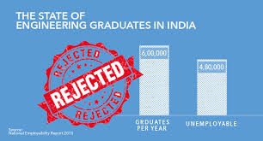
Result of this Obsession
80% of the Engineering graduates are unemployed.

Slide 11
Where the problem lies..?
Indian schools.
No creative education.
Fix our schools.

Slide 12


